Slide 1
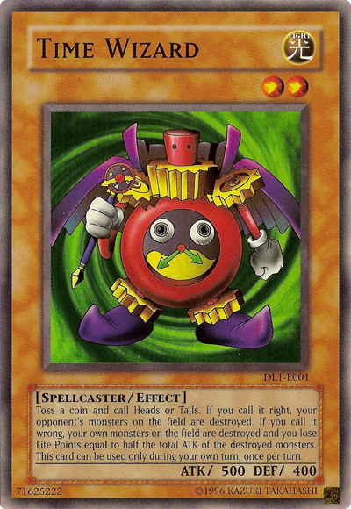
Time EQ: How many weeks have you been alive? (not including this one)
1

Slide 2
With your teacher spend the next five minutes creating a list of time facts.
Time

Slide 3
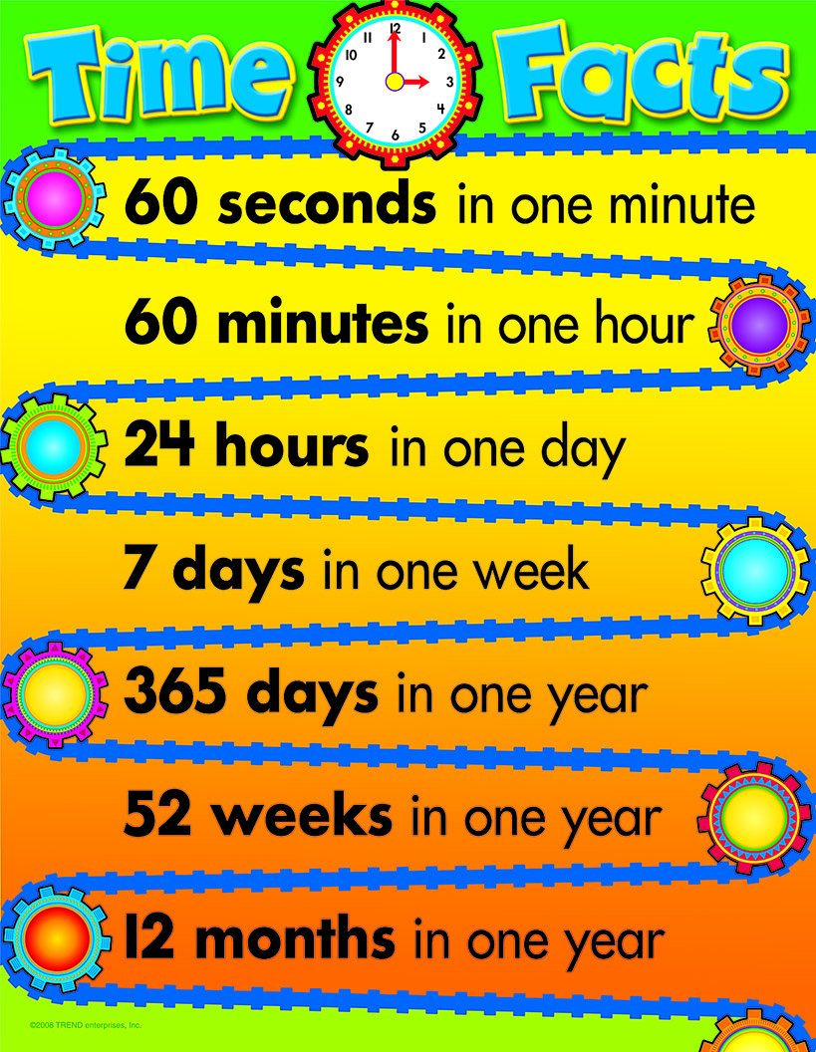
Some facts that you should have had.
The solar calendar recognizes that the Earth takes about 365 ¼ days to orbit the Sun. This gave us the leap year, one extra day every four years. Leap years have 366 days, 29th of February is the extra day.

Slide 4
Knowledge of Time Quick quiz. (LHS)
When is the next leap year?
Why do we need a leap year?
Which months have 31 days?
Which months have 30 days?
What does (BC) BCE or (AD) CE mean?
Is time the same, all over the planet, our globe called Earth?

Slide 5
24
7
30
Units of Time
Date:
EQ – How many weeks have you been alive? (not including this one)
The standard unit of time is seconds (s)
Time Conversion Caterpillar
Day Hour Minutes Second
Year Fortnight Week Day
How do I convert unit of time?
× 24
× 60
× 60
÷ 24
÷ 60
÷ 60
× 26
× 2
× 7
÷ 26
÷ 2
÷ 7

Slide 6
24
7
30
Units of Time
Date:
EQ – How many weeks have you been alive? (not including this one)
What is a decade?
Decade is 10 years
Century is 100 years.
What is a century?
Example :
A) 3 days = _______ minutes
3 days = 3 x 24 h 1 day = 24 hours
= 72 hours
= 72 x 60 min 1 hour = 60 minutes
= 4320 min
B) 30 months = ________ years
= 30 ÷ 12 1 year = 12 months
= 2 ½ years

Slide 7
Seconds | Minutes | Hours
306
 | 23
 |  | 1.5
 | 2
950
 | 209
 |  | 10
Days | Months | Years
700
 | 18
 |  | 4
10,000
 | 144
 |  | 50
 |  | 16

